Slide 1
Xtext Workshop
Thomas Fischl

Slide 2
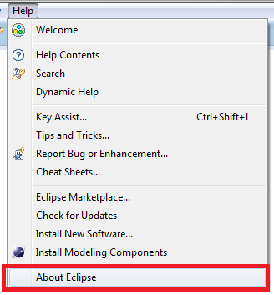
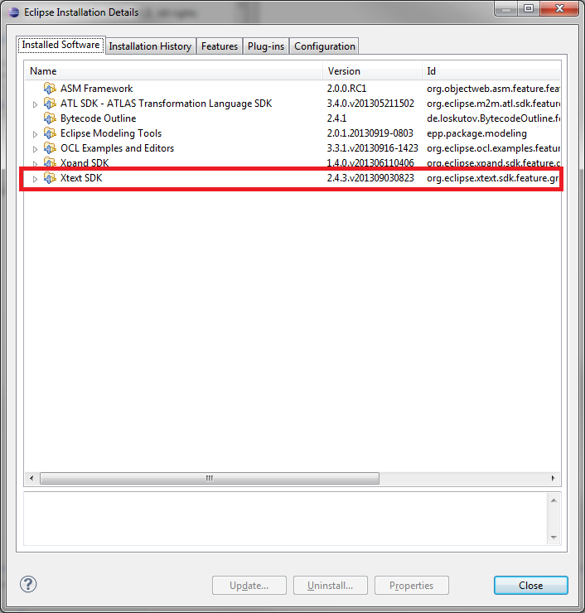
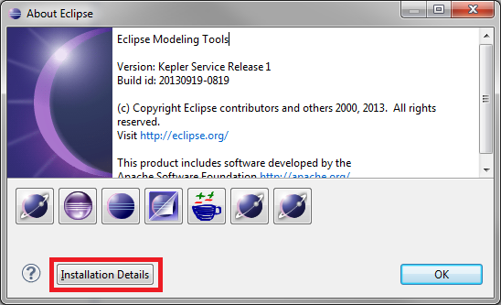
Xtext Install Check

Slide 3
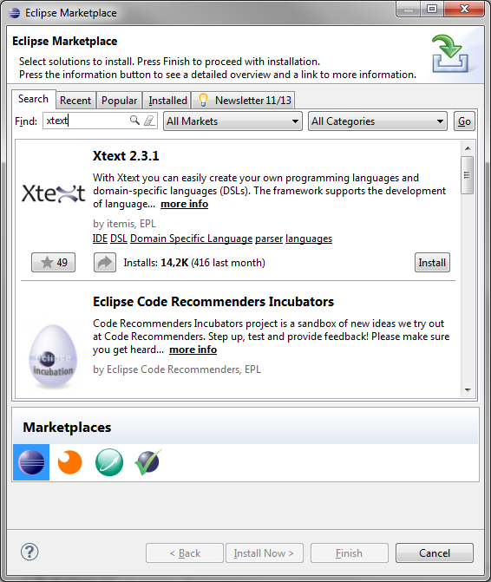
Eclipse Marketplace

Slide 4
Agenda
Xtext Overview
Grammar
Validator
Code Generator
Quick Fix
Unit Test
4 Exercises

Slide 5
What is Xtext?
Xtext is a framework for development of programming languages and domain specific languages. (Eclipse Xtext Website)
Eclipse Toplevel Project
Open Source Project
Highly Configurable Framework

Slide 6
What is a DSL?
A Domain-Specific Language (DSL) is a small programming language, which focuses on a particular domain. (Eclipse Xtext Website)

Slide 7


Who is behind Xtext?
itemis AG
Hauptsitz: Lünen, Deutschland
Consulting, Training
Sven Efftinge

Slide 8
xText Building Blocks
ANTLR
ECore Framework
OSGi
SWT
Google Guice
Xtend

Slide 9
What do you get from Xtext?
Compiler (Lexer, Parser, Reconciler)
AST (Ecore Model)
Serializer
Code Generator Environment
Eclipse Editor
Syntax Coloring
Content Assist
Validation and Quick Fixes
Refactoring

Slide 10
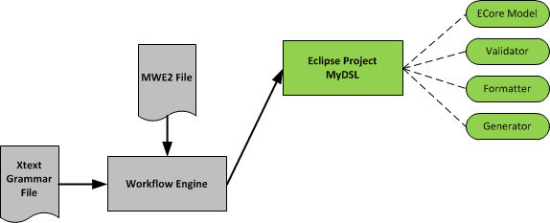
Xtext Workflow
Notes:
MWE2 => Modeling Workflow Engine 2

Slide 11
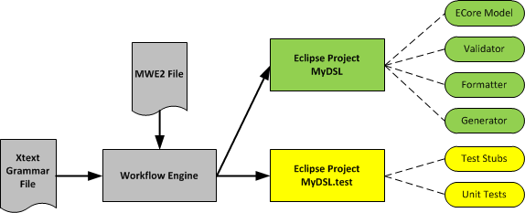
Xtext Workflow

Slide 12
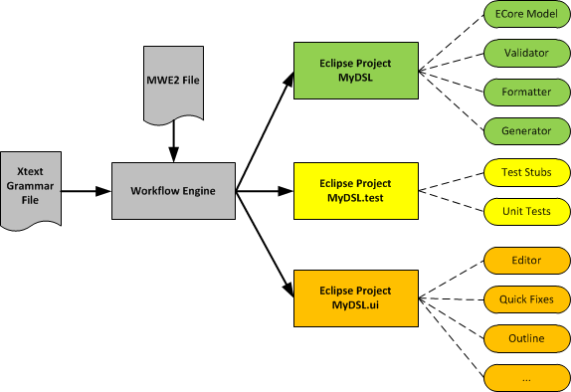
Xtext Workflow

Slide 13
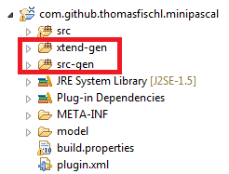
Never change generated code!

Slide 14
Xtext: Grammar

Slide 15
Xtext Grammar
Contains two parts of definitions
Language
Construction rules for the AST (Ecore Model)
Model: greetings+=Greeting*;
Greeting: 'Hello' name=NAME '!';
terminal NAME returns ecore::EString: ('A'..'Z') ('a'..'z')*;
Model: greetings+=Greeting*;
Greeting: 'Hello' name=NAME '!';
terminal NAME returns ecore::EString: ('A'..'Z') ('a'..'z')*;

Slide 16

Example - EBNF
Model =
{Greeting} .
Greeting =
"Hello" NAME "!" .
NAME =
('A'..'Z') {'a'..'z'} .

Slide 17
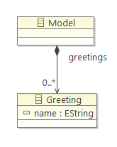
Example - Xtext Grammar
grammar org.xtext.example.mydsl.MyDsl // language name
with org.eclipse.xtext.common.Terminals // include predefined terminal rules
hidden (ML_COMMENT) // define comment style
generate myDsl // generate an ecore model for this grammar
"http://www.xtext.org/example/mydsl/MyDsl"
Model:
greetings+=Greeting*;
Greeting:
'Hello' name=NAME '!';
terminal NAME returns ecore::EString:
('A'..'Z') ('a'..'z')*;
terminal ML_COMMENT: // terminal rule
'/*'->'*/';

Slide 18
Xtext Grammar: Language

Slide 19
Xtext Grammar: Parser Rule
VarDecl:
"VAR" vars+=
VarName ("," vars+=VarName)*
":" "INTEGER" ";" ;
Hint: Each parser rule is converted into an ECore class.

Slide 20
Xtext Grammar: Terminal String
VarDecl:
"VAR" vars+=
VarName ("," vars+=VarName)*
":" "INTEGER" ";";

Slide 21
Xtext Grammar: Alternatives
Fact:
var=IDENT |
number=NUMBER |
"(" expr=Expr ")";

Slide 22
Xtext Grammar: Repetition
Expr:
term=Term (terms+=ExprExt)*;

Slide 23
Xtext Grammar: Grouping
Expr:
term=Term (terms+=ExprExt)*;

Slide 24
Xtext Grammar: Terminal Rule
terminal ID :
('a'..'z'|'A'..'Z'|'_') ('a'..'z'|'A'..'Z'|'_'|'0'..'9')*;

Slide 25
Xtext Grammar: AST

Slide 26
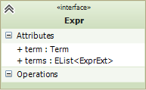
Xtext Grammar: Assignments
Expr:
term=Term (terms+=ExprExt)*;

Slide 27
Xtext Grammar: Cross Reference
Transition :
event=[Event] '=>' state=[State];
Event: ....;

Slide 28
Xtext Grammar: Terminal Rule
terminal NUMBER returns ecore::EInt:
('0'..'9')+;

Slide 29
Demo Project: Mini Pascal

Slide 30
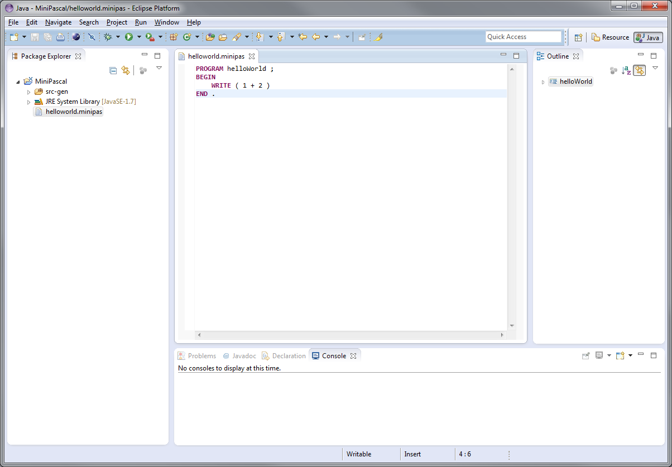
Editor

Slide 31
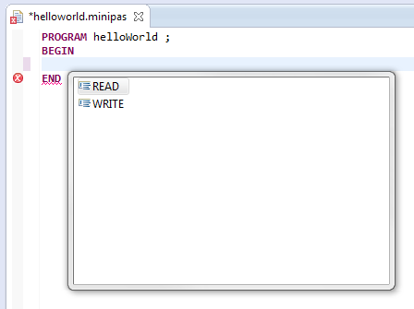
Content Assist

Slide 32
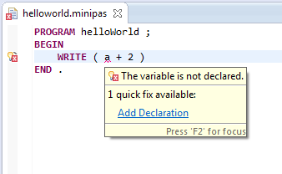
Validator & Quick Fix

Slide 33
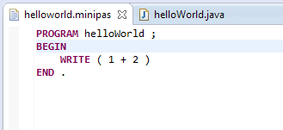
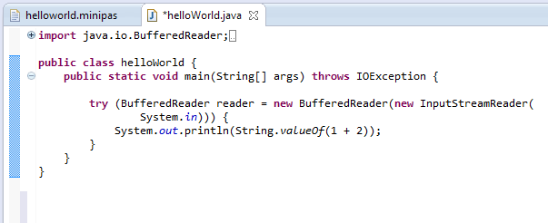
Code Generator

Slide 34
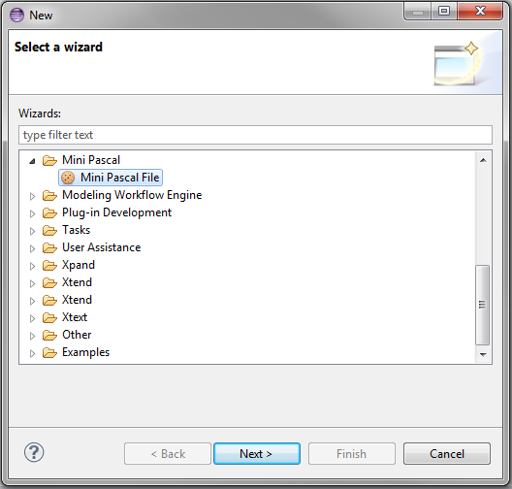
New File Wizard

Slide 35
Exercise 1
Mini Pascal Xtext Grammar

Slide 36
Mini Pascal Grammar – EBNF
MP = "PROGRAM" ident ";"
[ VarDecl ]
"BEGIN" StatSeq "END" "." .
VarDecl = "VAR" ident { "," ident } ":" "INTEGER" ";” .
StatSeq = Stat { ";" Stat } .
Stat = [ ident ":=" Expr
| "READ" "(" ident ")"
| "WRITE" "(" Expr ")"
] .
Expr = Term { ( "+" | "-" ) Term } .
Term = Fact { ( "*" | "/" ) Fact } .
Fact = ident | number | "(" Expr ")" .

Slide 37
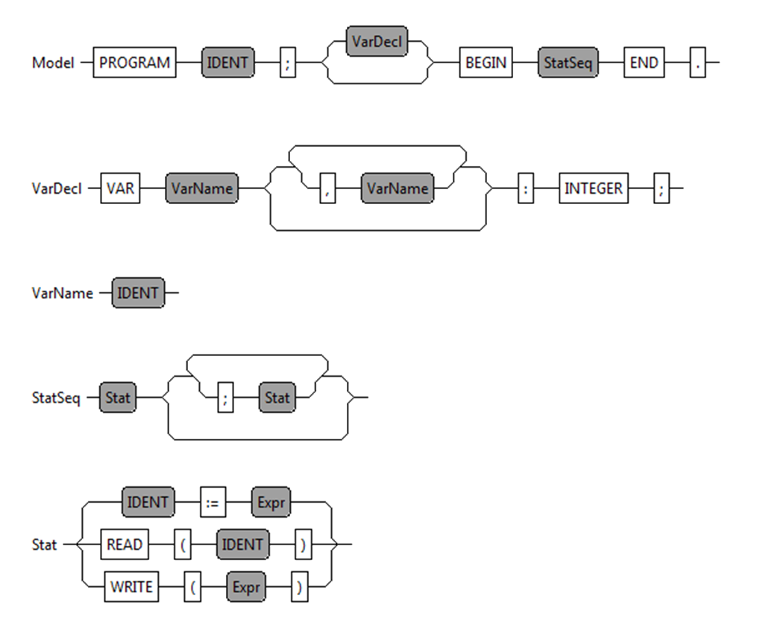
Mini Pascal - Syntax Diagram

Slide 38
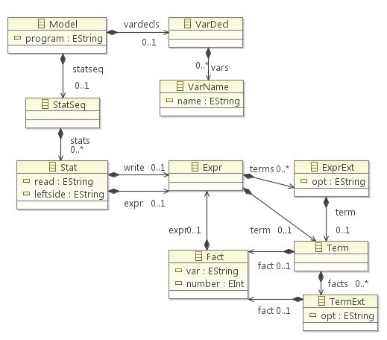
Mini Pascal – ECore Diagram

Slide 39
Mini Pascal Grammar – Xtext (1)
Model:
"PROGRAM" program=IDENT ";"
(vardecls=VarDecl)?
"BEGIN"
statseq=StatSeq
"END" ".";
VarDecl:
"VAR" vars+=VarName ("," vars+=VarName)* ":" "INTEGER" ";" ;
VarName:
name=IDENT ;

Slide 40
Mini Pascal Grammar – Xtext (2)
StatSeq:
stats+=Stat (";" stats+=Stat)* ;
Stat:
leftside=IDENT ":=" expr=Expr
| "READ" "(" read=IDENT ")"
| "WRITE" "(" write=Expr ")" ;

Slide 41
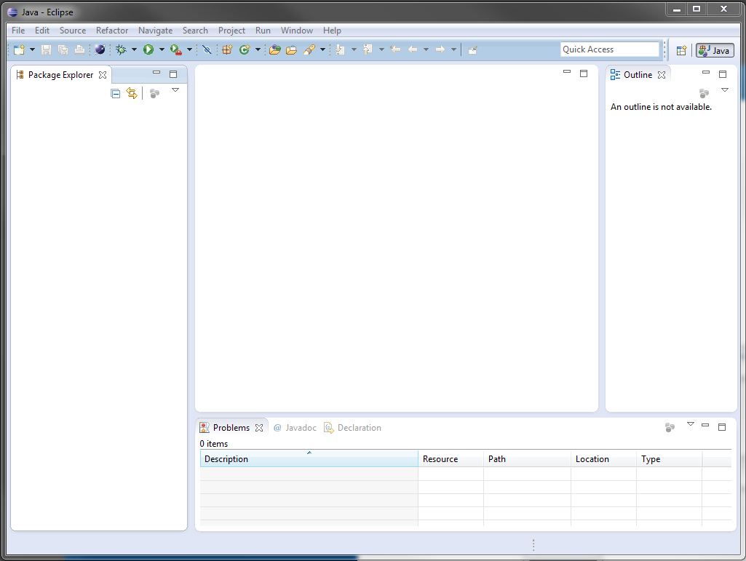
Open Eclipse with a new workspace

Slide 42
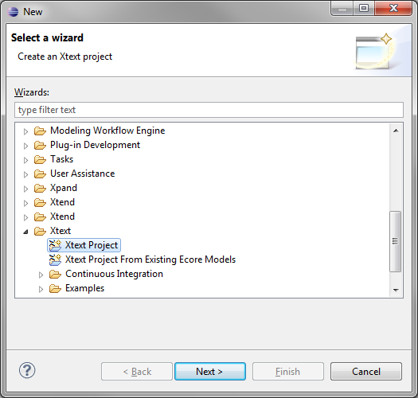
New Xtext Project

Slide 43
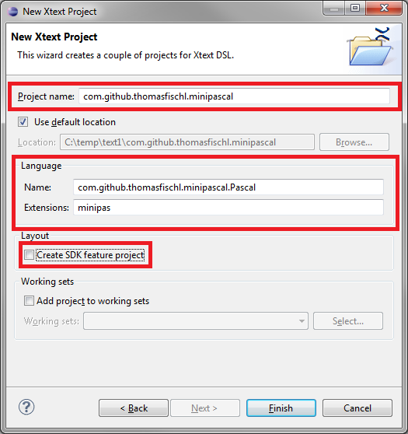
Xtext Project Properties
com.github.thomasfischl.minipascal
com.github.thomasfischl.minipascal.Pascal
minipas

Slide 44
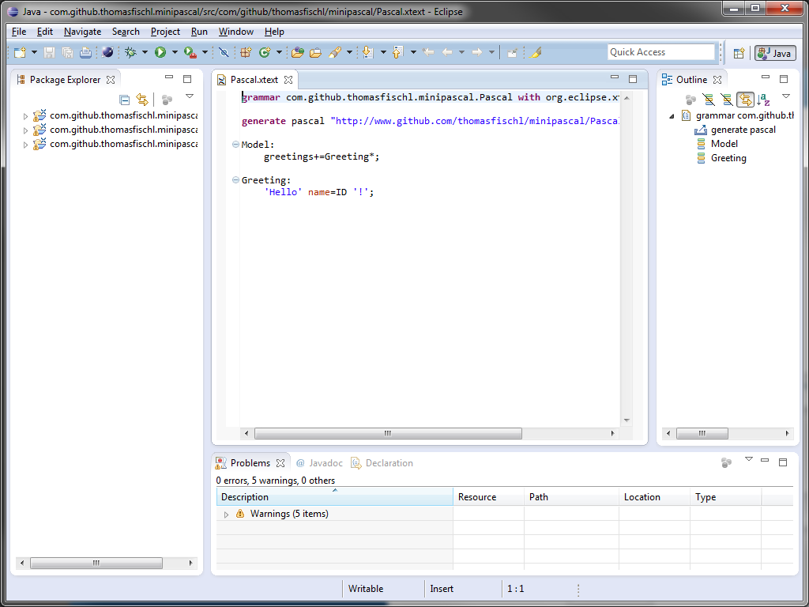
Open Pascal.xtext File

Slide 45
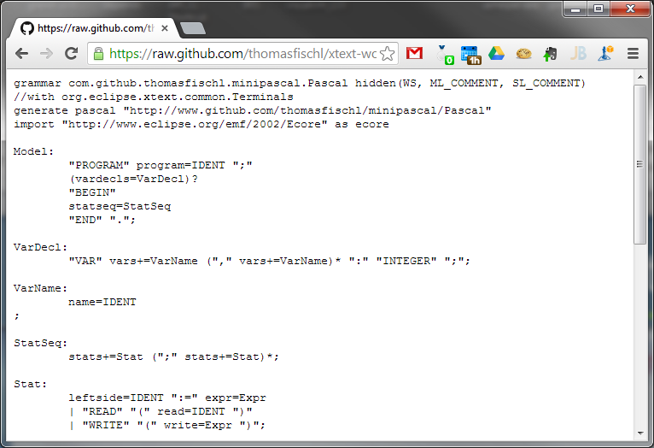
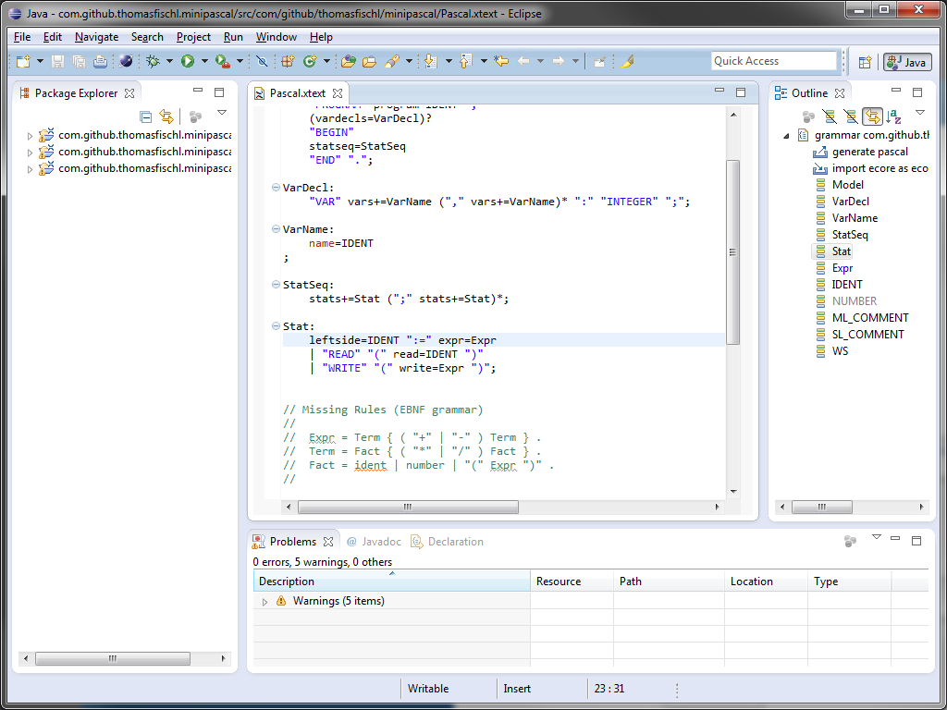
Download Grammar Template
http://goo.gl/7uPtOx

Slide 46
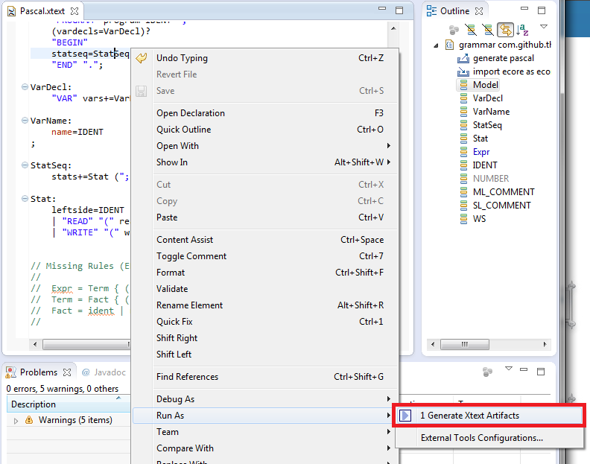
Generate Artefacts

Slide 47
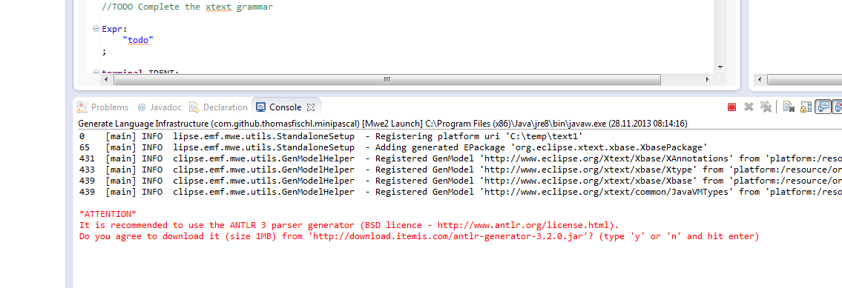
Download ANTLR

Slide 48
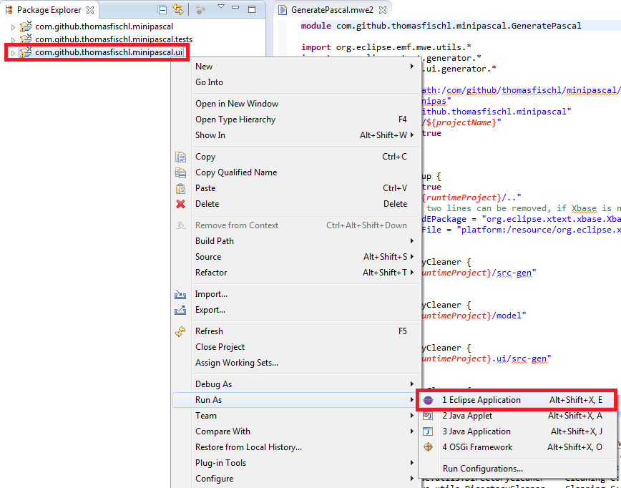
Run Xtext Project

Slide 49
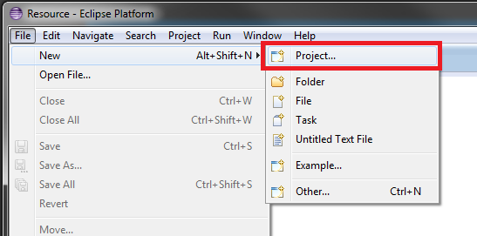
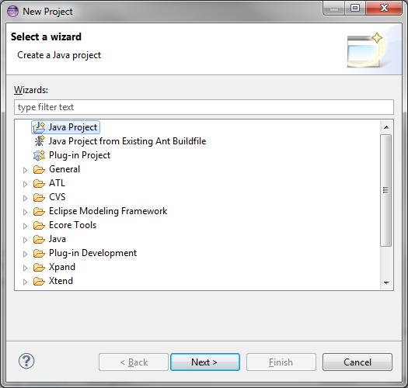
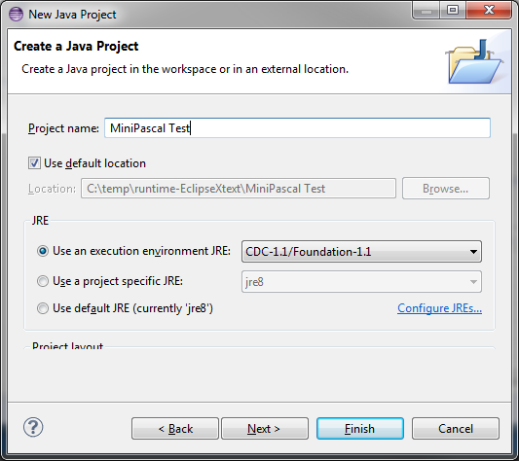
Create Java Project

Slide 50
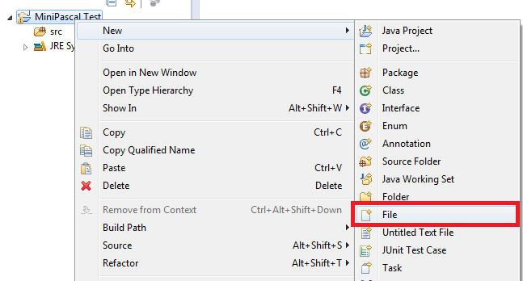
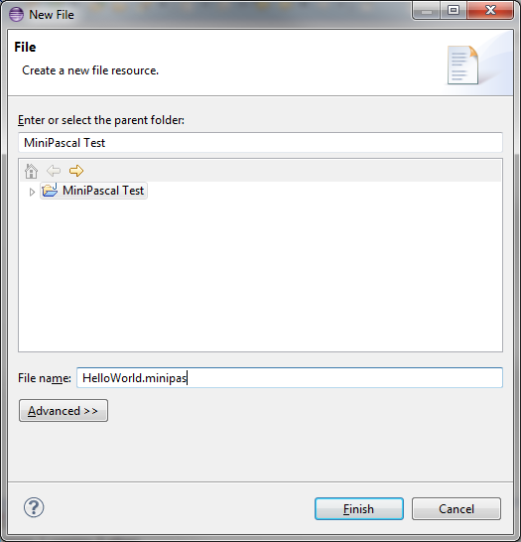
Create a HelloWorld.minipas File

Slide 51
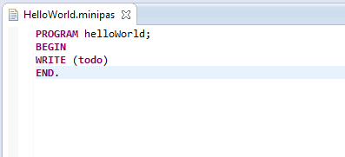
Write our first program

Slide 52
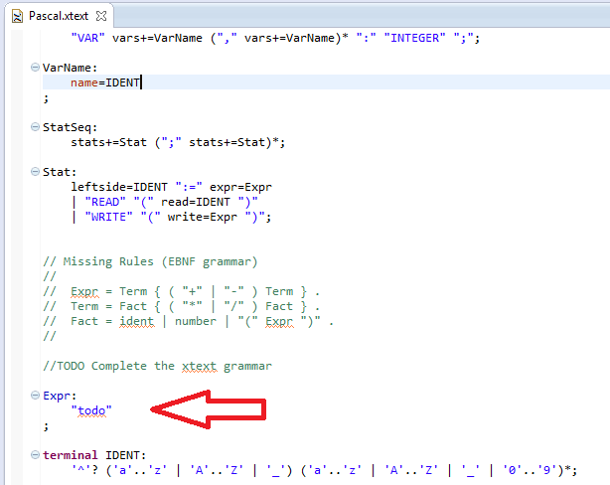
Complete Xtext Grammar

Slide 53
Exercise: Description
Download the grammar artefact and copy it into the Pascal.xtext file
http://goo.gl/7uPtOx
Complete the grammar
Generate all artefacts
Run Eclipse with Plugin

Slide 54
Mini Pascal Grammar – Xtext (3)
http://goo.gl/7rNPLB
Expr:
term=Term (terms+=ExprExt)*;
ExprExt:
(opt="+" | opt="-") term=Term ;
Term:
fact=Fact (facts+=TermExt)*;
TermExt:
(opt="*" | opt="/") fact=Fact ;
Fact:
var=IDENT | number=NUMBER | "(" expr=Expr ")";

Slide 55
Xtext: Validation Framework

Slide 56
Xtext Validation Framework
Automatic Validation
Syntactical Validation
Cross-link Validation
Custom Validation
Extends AbstractPascalJavaValidator
Implement @Check methods

Slide 57
Xtext Validation API
Add Information:
protected void info(String message, EStructuralFeature feature , int index)
Add Warning:
protected void warning(String message, EStructuralFeature feature, int index)
Add Error:
protected void error(String message, EStructuralFeature feature, int index)

Slide 58
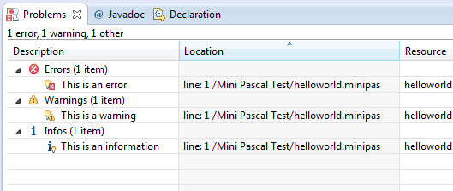
Xtext Validation API

Slide 59
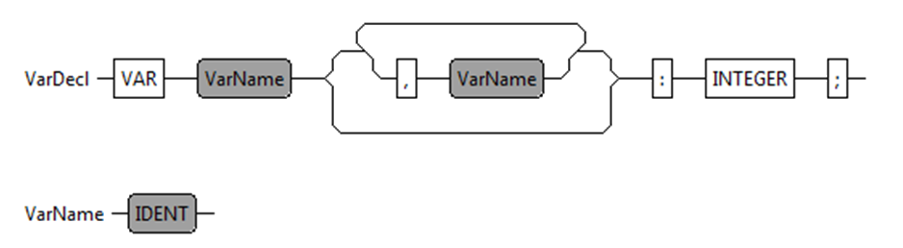
Custom Validation API
public class PascalJavaValidator extends AbstractPascalJavaValidator {
@Check
public void checkVariableName(VarName name) {
// Validation Implementation
}
}

Slide 60
Exercise 2
Double Variable Declaration Validator

Slide 61
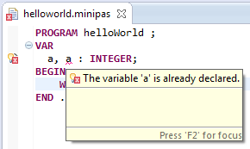
Double Variable Declaration Check

Slide 62
Exercise: Description
Download the validation artefact and copy it into the PascalJavaValidator Java file
http://goo.gl/JpFXnv
Complete the validator
Run the eclipse plugin

Slide 63
Double Variable Declaration Check
@Check
public void checkDoubleVariableDeclaration(VarDecl varDecl) {
Set<String> varNames = new HashSet<String>();
for (VarName var : varDecl.getVars()) {
if (varNames.contains(var.getName())) {
String msg = String.format("The variable '%s' is already
declared.", var.getName());
error(msg, var, PascalPackage.Literals.VAR_NAME__NAME,
REMOVE_VARIABLE, var.getName());
} else {
varNames.add(var.getName());
}
}
}
http://goo.gl/eVMfmV

Slide 64
Xtext: Code Generator Framework

Slide 65
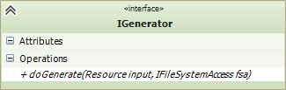
Xtext Code Generator Framework
Implement IGenerator interface
Java
Xtend

Slide 66
Xtext Code Generator Framework
Bind IGenerator implemenation in the RuntimeModel class
public abstract class AbstractPascalRuntimeModule extends DefaultRuntimeModule {
public Class<? extends IGenerator> bindIGenerator() {
return PascalGenerator.class;
}
}

Slide 67
Generator Implemenation (Xtend)
class PascalGenerator implements IGenerator {
override void doGenerate(Resource resource, IFileSystemAccess fsa) {
for (e : resource.allContents.toIterable.filter(Model)) {
fsa.generateFile(e.program + ".java", e.compile)
}
}
def CharSequence compile(Model model) '''
Implemenation
'''
}

Slide 68
Exercise 3
Expression Code Generator

Slide 69
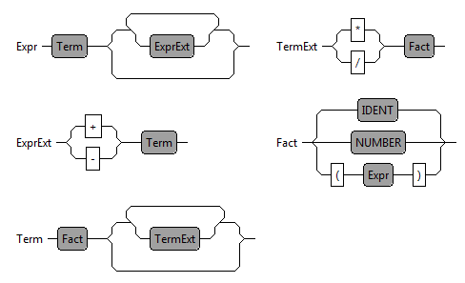
Expression Code Generator

Slide 70
Exercise: Description
Download the generator artefact and copy it into the PascalGenerator Xtend file
http://goo.gl/Vm5QWk
Complete the generator
Run the eclipse plugin

Slide 71
Xtext: Formatter

Slide 72
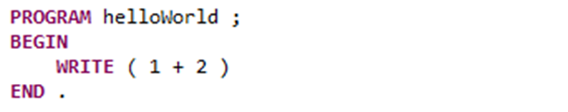
Xtext Formatter
The Formatter is a pretty print function for the DSL. (STRG + SHIFT + F)

Slide 73
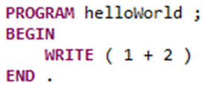
Formatter Implemenation
@Override
protected void configureFormatting(FormattingConfig c) {
c.setAutoLinewrap(120);
c.setLinewrap().before(grammarAccess.getVarDeclRule());
c.setLinewrap().after(grammarAccess.getVarDeclRule());
c.setLinewrap().after(grammarAccess.getVarDeclAccess().getVARKeyword_0());
}
}

Slide 74
Xtext: Quick Fix

Slide 75
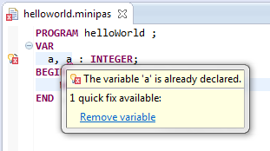
A Quick Fix …
helps the developer to improve his performance! (STRG+ 1)
is connect with a validator message.
can modify the model or the text representation.

Slide 76
Validator Implementation
@Check
public void checkDoubleVariableDeclaration(VarDecl varDecl) {
Set<String> varNames = new HashSet<String>();
for (VarName var : varDecl.getVars()) {
if (varNames.contains(var.getName())) {
String msg = String.format("The variable '%s' is already
declared.", var.getName());
error(msg, var, PascalPackage.Literals.VAR_NAME__NAME,
REMOVE_VARIABLE, var.getName());
} else {
varNames.add(var.getName());
}
}
}

Slide 77
Quick Fix Implementation
@Fix(PascalJavaValidator.REMOVE_VARIABLE)
public void fixUnusedVariable(final Issue issue, IssueResolutionAcceptor acceptor) {
String msg = String.format("Remove unused variable '%s'.", issue.getData()[0]);
acceptor.accept(issue, "Remove variable", msg, "upcase.png", new ISemanticModification() {
@Override
public void apply(EObject element, IModificationContext context) {
if (element instanceof VarName) {
VarDecl parent = (VarDecl) element.eContainer();
parent.getVars().remove(element);
if (parent.getVars().isEmpty()) {
ModelImpl model = (ModelImpl) parent.eContainer();
model.setVardecls(null);
}
}
}
});
}

Slide 78
Xtext: Unit Test

Slide 79
Unit Test for the Xtend Generator
@RunWith(XtextRunner.class)
@InjectWith(PascalInjectorProvider.class)
public class PascalGeneratorTest {
@Inject
IGenerator generator;
@Inject
ParseHelper<Model> parser;
// TODO Unit Test
}

Slide 80
Unit Test for the Xtend Generator
@Test
public void testHelloWorld() throws Exception {
testMiniPasFile("helloworld");
}
private void testMiniPasFile(String name) throws Exception {
Model model = parser.parse(readFile(name + ".minipas"));
assertNotNull(model);
InMemoryFileSystemAccess fsa = new InMemoryFileSystemAccess();
generator.doGenerate(model.eResource(), fsa);
assertEquals(1, fsa.getTextFiles().size());
String result = fsa.getTextFiles().values().iterator().next().toString();
assertEquals(readFile(name + ".output"), result);
}

Slide 81
Xtext: ByteCode Generator

Slide 82
Summary
Textual DSL Framework
Highly configurable and flexible framework
Easy code generator implemenation
Demo Project:
https://github.com/thomasfischl/xtext-workshop

Slide 83


Books
http://www.amazon.de/Domain-Specific-Languages-Addison-Wesley-Signature
http://www.amazon.de/DSL-Engineering-Designing-Implementing-Domain-Specific

Slide 84
More Infos
ANTLR http://www.antlr.org/
Xtext http://www.eclipse.org/Xtext/
Xtend http://xtend-lang.org
Google Guice: https://code.google.com/p/google-guice/
EMF: http://www.eclipse.org/modeling/emf/

